Slide 1
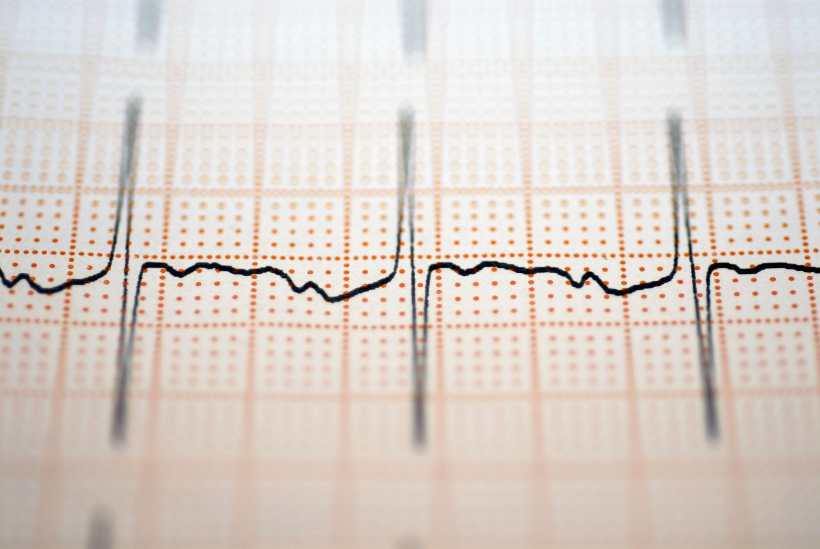
Using Machine Learning to Predict Hypertension
Tiffany Davidson
Applied Science and Analytics
Spring 24
Machine Learning Data 303-1

Slide 2
Question
Do the odds of developing hypertension increase with certain variables? Can we use machine learning to predict if an individual will develop hypertension?

Slide 3

Introduction
Hypertension, or having a blood pressure, is where the Systolic reading is 140 mm Hg or higher and the Diastolic reading is 90 mm Hg or higher. It is costly and often difficult to manage. Hypertension is a risk factor for cardiovascular diseases including strokes. (Appel, Lawrence, 2003). Lowering blood pressure can decrease heart attacks and heart failure. Medication and adjusting lifestyle habits are the usual approaches to treating hypertension. Increasing your intake of potassium, reducing body weight, and a reduction of salt intake are some of the recommended actions to combat hypertension. (Appel, Lawrence, 2003).

Slide 4

Purpose of Research
Previous research has focused on hypertension as a component of cardiovascular health. I found that multiple variables such as age and lifestyle choices had been discussed but when doing nutrition counseling many times patients did not grasp the big picture. The purpose of this research is to explore what variables that the public can control, play a role in the likelihood of developing hypertension.

Slide 5

Previous Machine Learning Methods
The article, “Prediction of Incident Hypertension Within the Next Year: Prospective Study Using Statewide Electronic Health Records and Machine Learning”, utilized the data from patient electronic health records. XGBoost, a machine learning algorithm was used to model build. The algorithm created classification trees and gave a final predictive risk score to each participant. They found that the population most at risk were those over the age of 50 with chronic conditions. Chengyin Y, et al 2018

Slide 6

Previous Machine Learning Methods
In the research article “A Machine-Learning-Based Prediction Method for Hypertension Outcomes Based on Medical Data”, the researchers initially extracted information from the patients and then proceeded to use that information to predict the possibility of hypertension. They proposed a model that combined recursive feature elimination with a cross-validation method and classification algorithm. They used four classification algorithms (support vector machine (SVM), C4.5 decision tree, random forest (RF), and extreme gradient boosting (XGBoost)) to predict patient outcomes by using their optimal features subset. XGBoost was found to be the best prediction performance, and its accuracy, F1, and area under receiver operating characteristic curve (AUC) values are 94.36%, 0.875, and 0.927, respectively, using the optimal features subset. Chang W, 2019

Slide 7

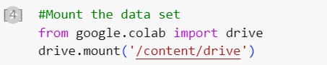
Mount the data set

Slide 8
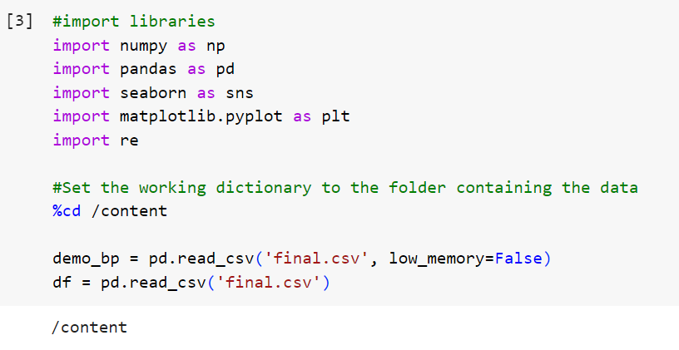
Imports and setting the working directory

Slide 9
Data
The National Health and Nutrition Examination Survey (NHANES) provided the data. NHANES is a series of studies designed to analyze the health and nutritional status of adults and children in the United States. It uses interviews coupled with physical exams. NHANES is a program under the National Center for Health Statistics (NCHS) which is part of the Centers for Disease Control and Prevention (CDC).
The datasets used came from the NHANES 2017 March 2020 Pre-Pandemic data. It contained the demographics, BMI, Blood pressure, and smoking data from that time. I chose this set to study the effects that age, smoking, BMI, gender, race, and having high cholesterol have on hypertension or high blood pressure. The study examines the question: Can we build a model to predict a person’s likelihood of developing hypertension based on these variables?

Slide 10

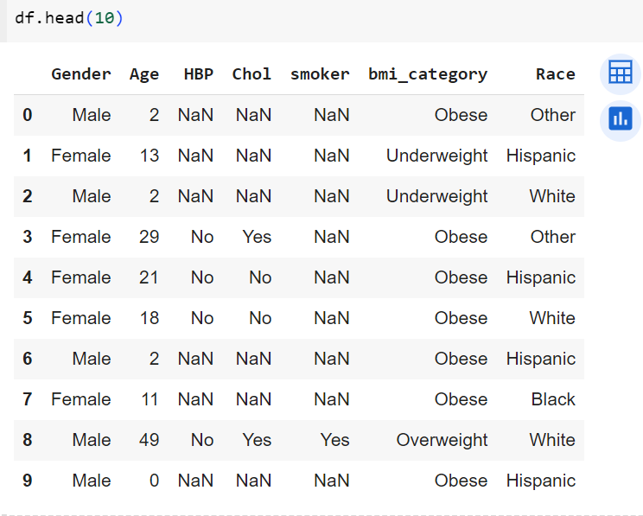
Exploratory Data Analysis and Visualization

Slide 11
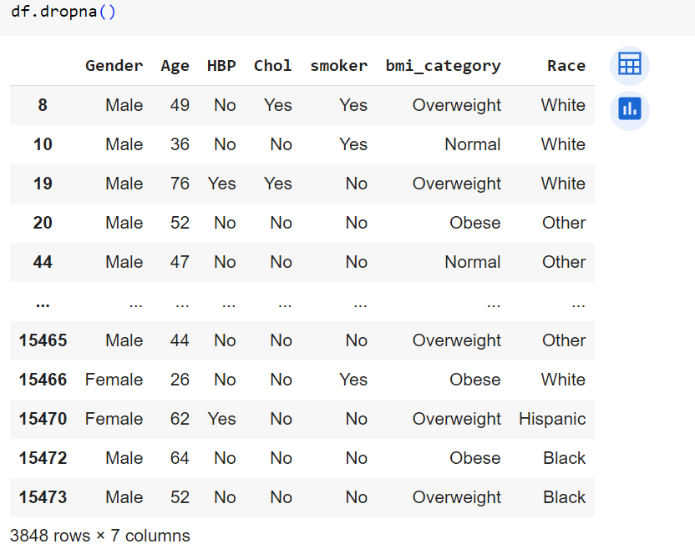
Exploratory Data Analysis and Visualization

Slide 12
Issues
Categories for adult BMI had to be created.
Example: Underweight BMI for an adult is under 18.5(k/m^2)
The ‘Yes’ and ‘Sometimes’ responses for smoking were combined into one category as yes.

Slide 13

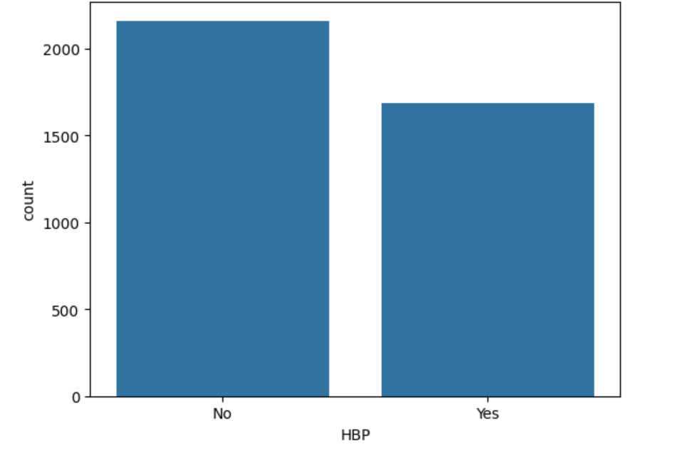
Plotting the data
Count for high blood pressure

Slide 14

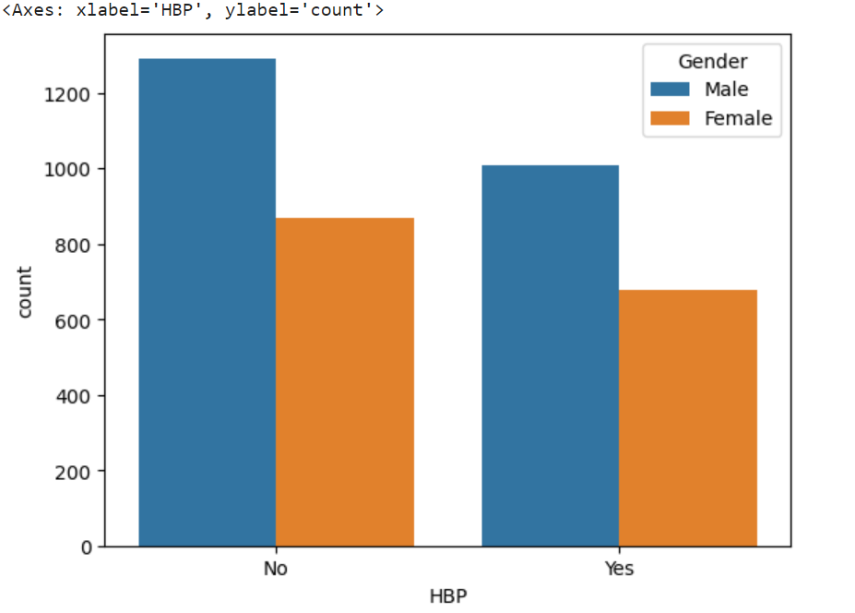
Plotting the data
Comparing high blood pressure between men and women

Slide 15
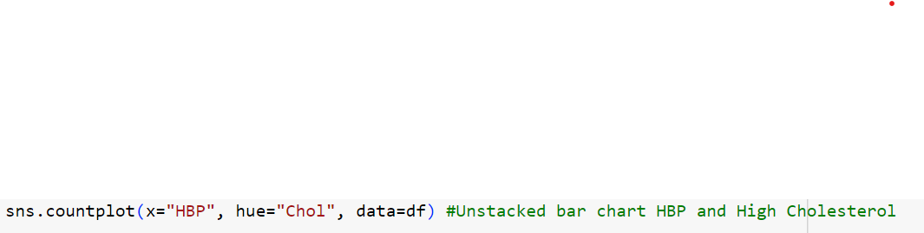
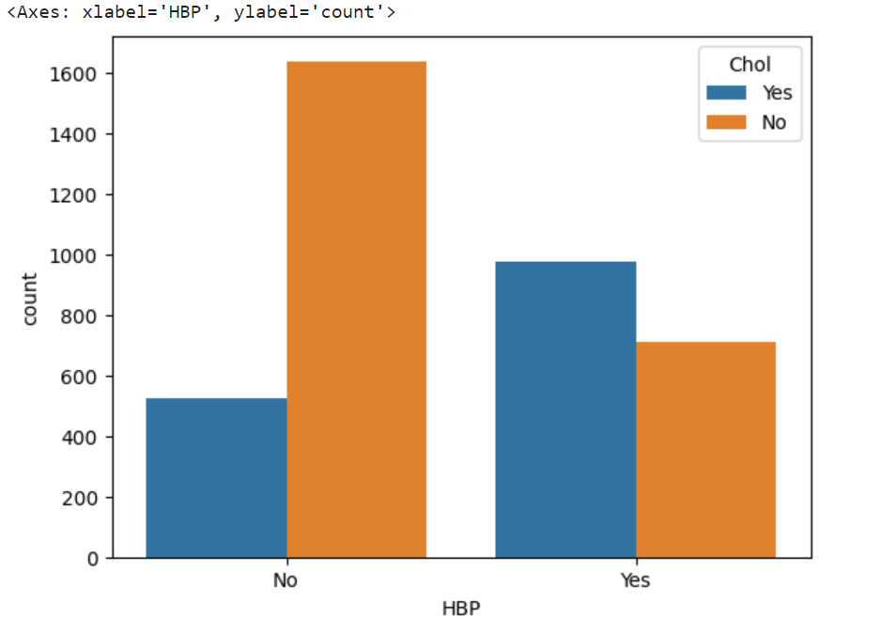
Plotting the data
High blood pressure and high cholesterol.

Slide 16

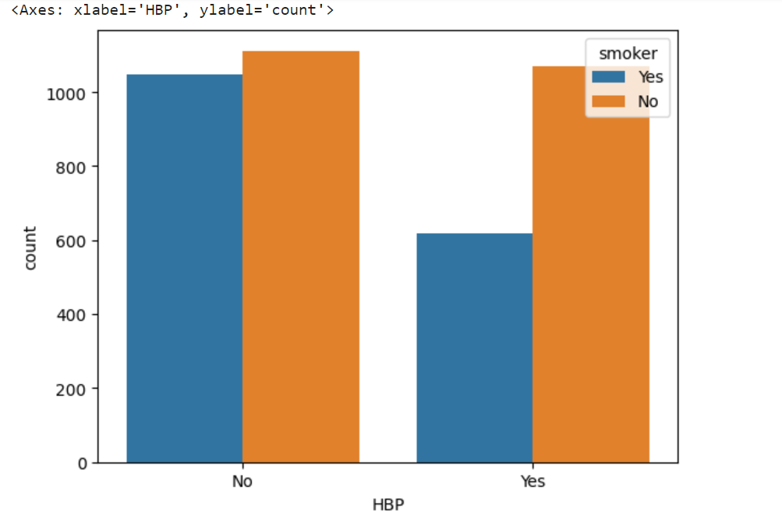
Plotting the data
Comparing high blood pressure in smokers

Slide 17

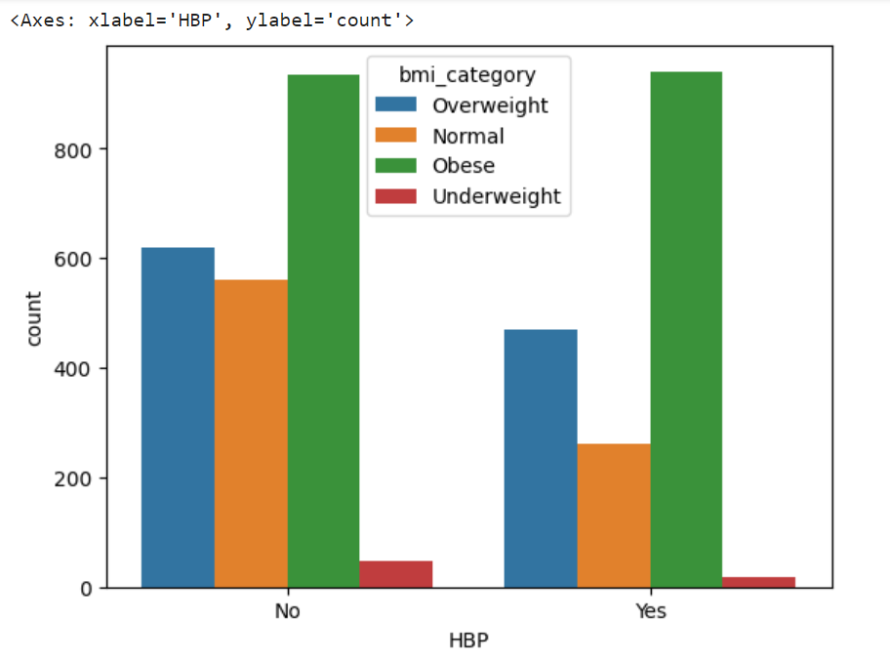
Plotting the data
Comparing high blood pressure among different BMI categories

Slide 18

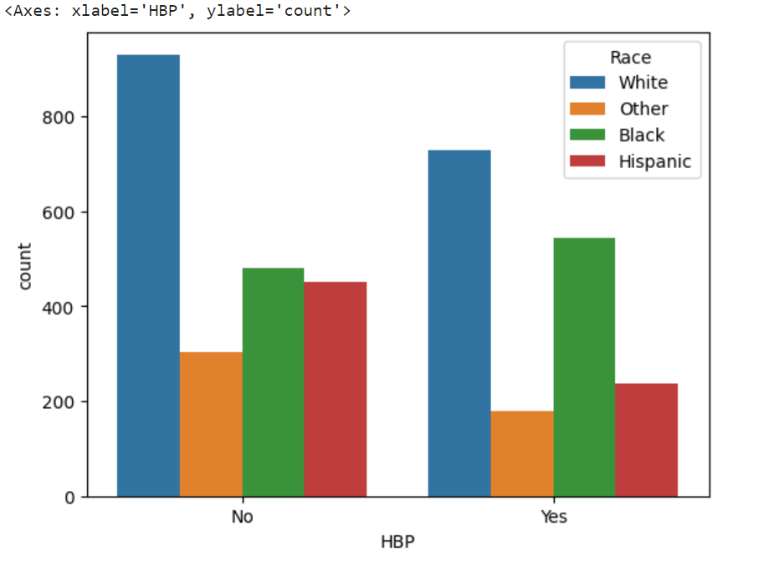
Plotting the data
Comparing high blood pressure among different races.

Slide 19

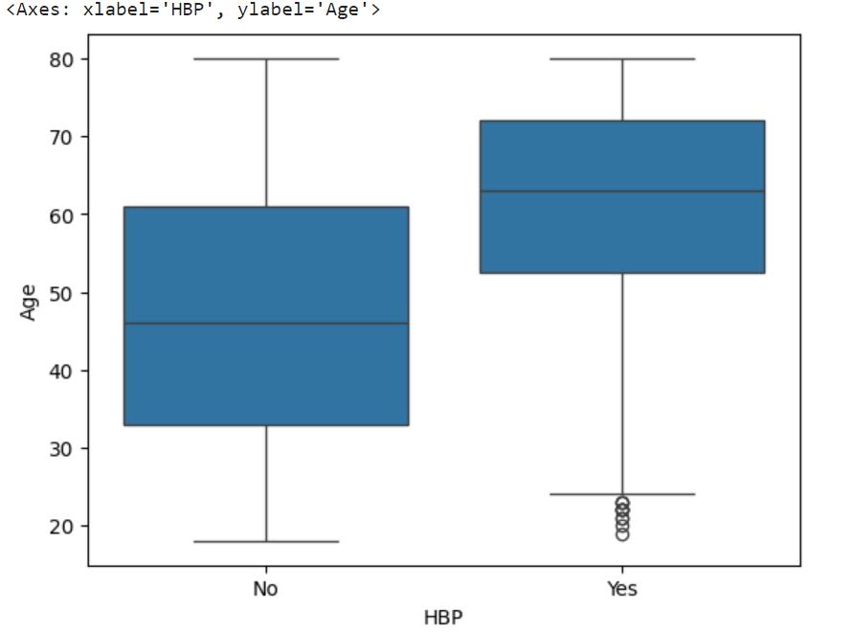
Plotting the data
Comparing high blood pressure among ages.

Slide 20
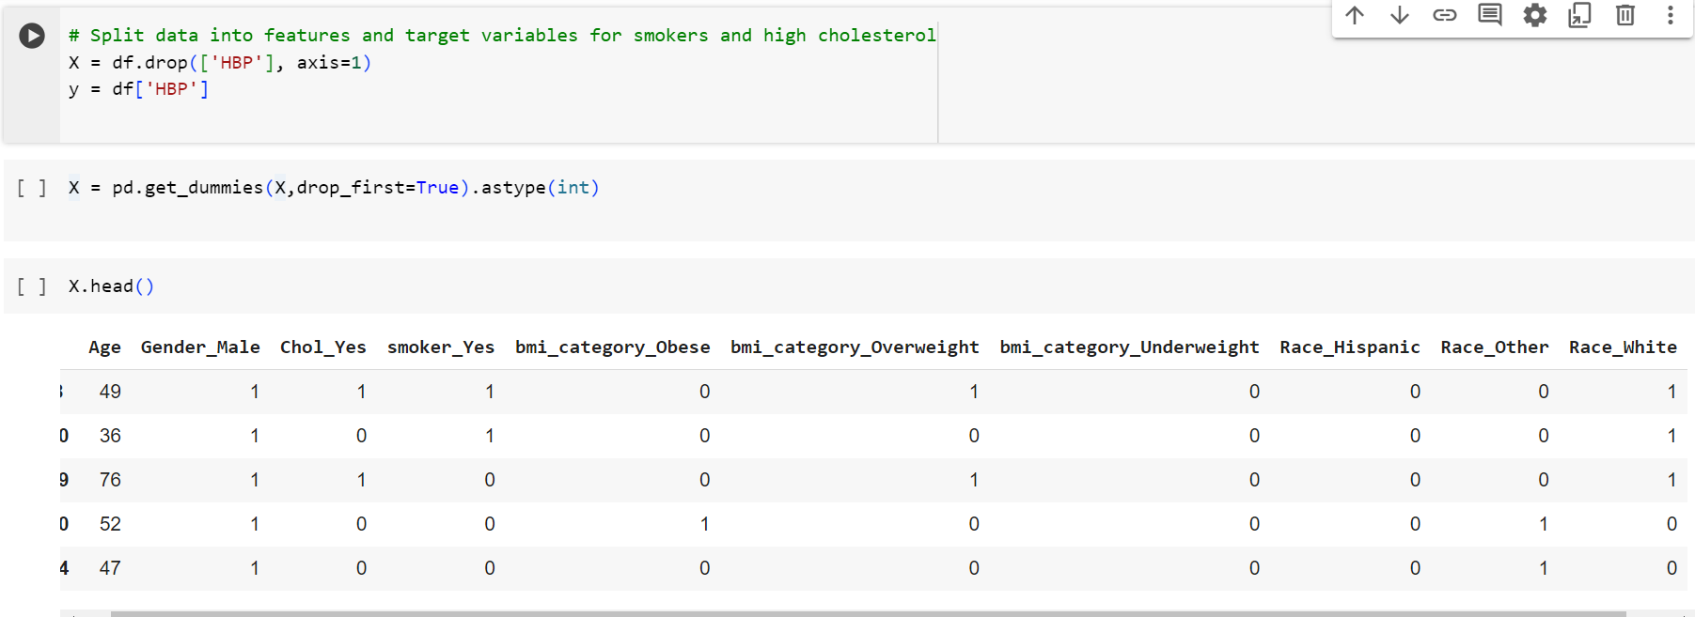
Train|Test Split and Scaling

Slide 21
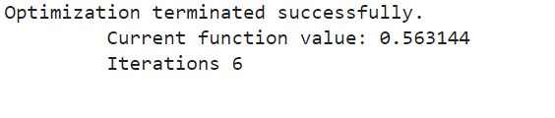
Fit The Model

Slide 22
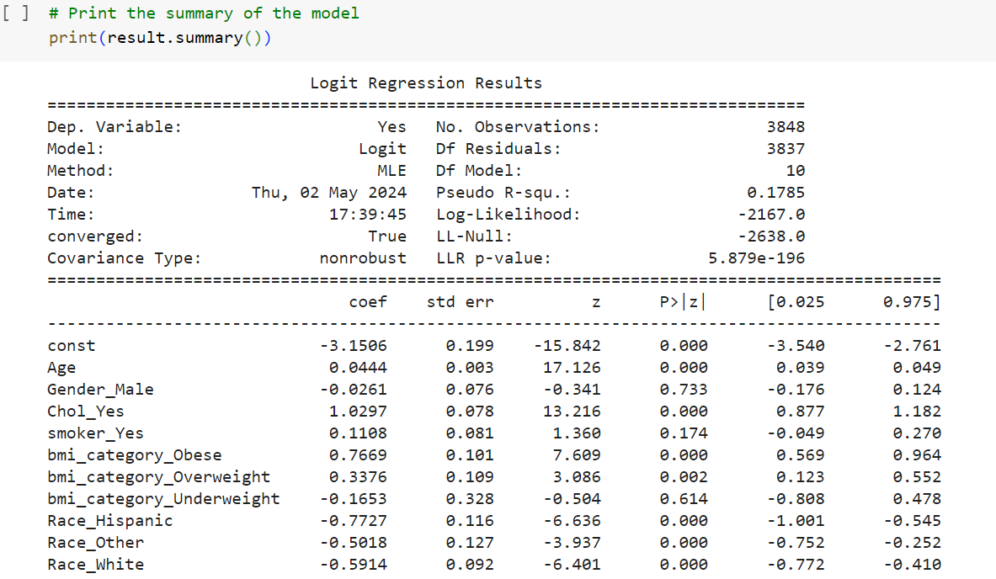
Logit Regression Results
Age and high cholesterol are significant.
Patients who are older and have high cholesterol are also more likely to have high blood pressure.

Slide 23
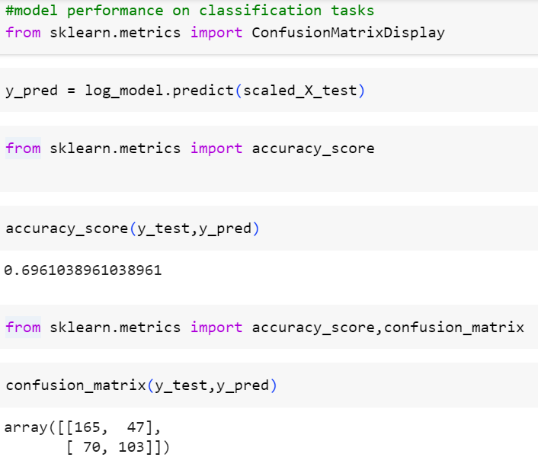
Model Performance on Classification Tasks

Slide 24
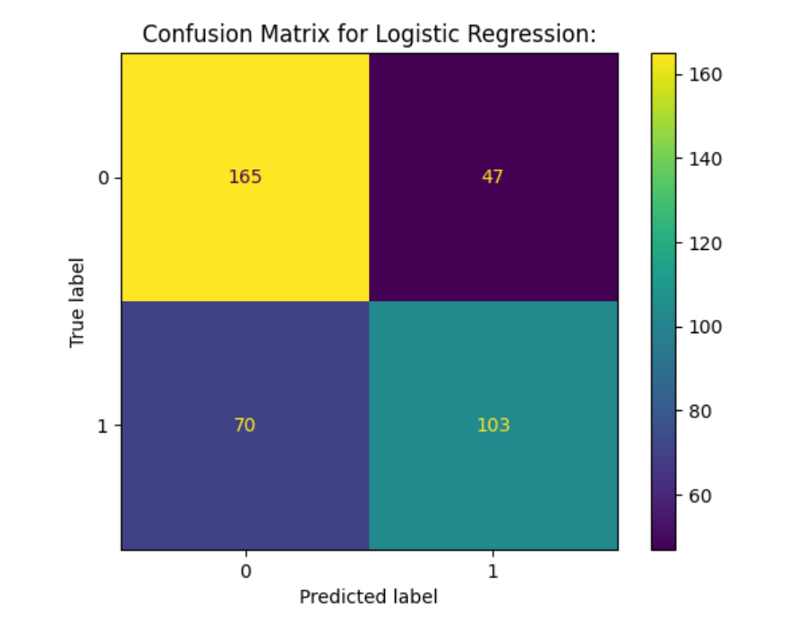
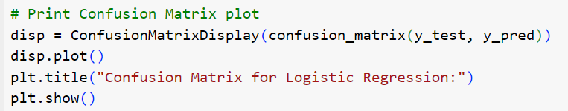
Confusion Matrix for Logistic Regression

Slide 25
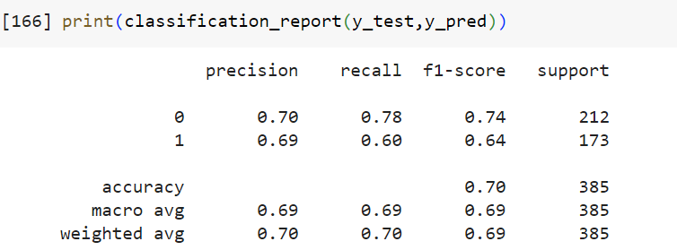
Classification Report y_test, y_predict

Slide 26
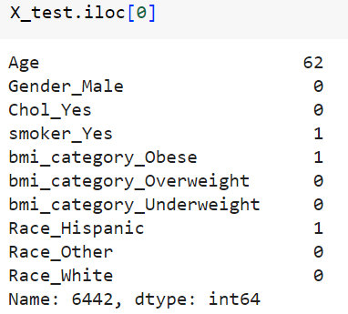
Test data
In the test data we split the data into training and testing. We tested a 62-year-old smoker who was obese. When the test was checked, the response was yes. This means that from the data this person has hypertension. We predict that given these features they have hypertension so the model predicted correctly.

Slide 27
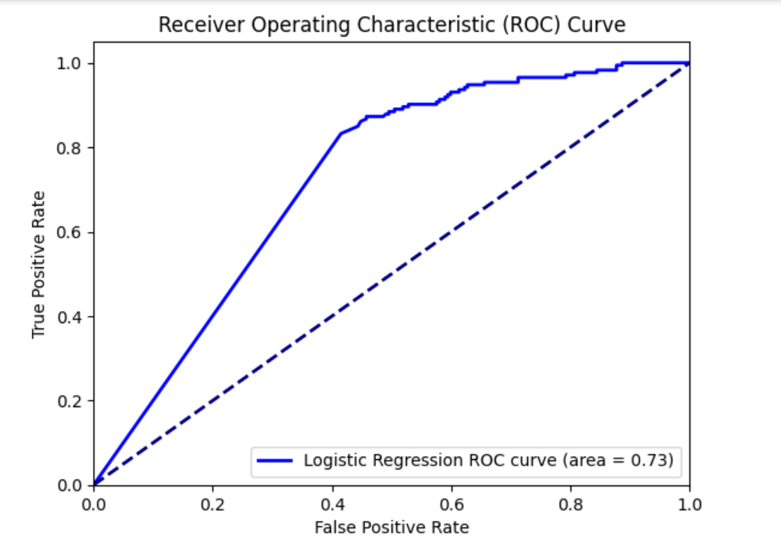
ROC Curve and Area for Logistic Regression

Slide 28
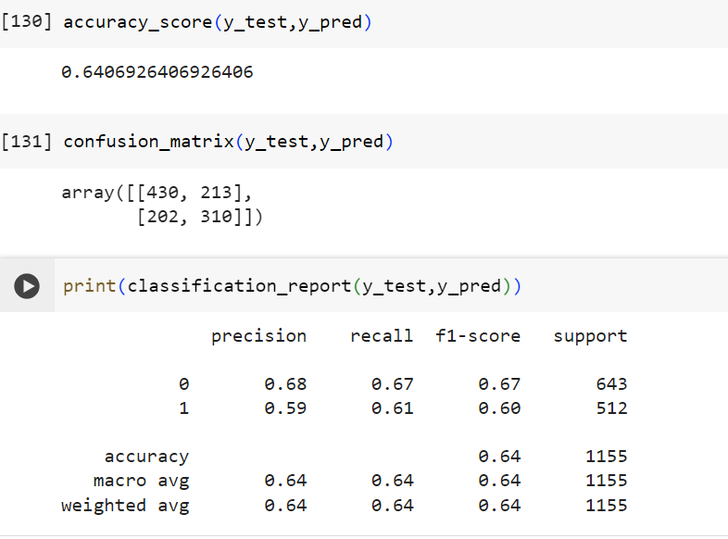
KNN Model Evaluation

Slide 29
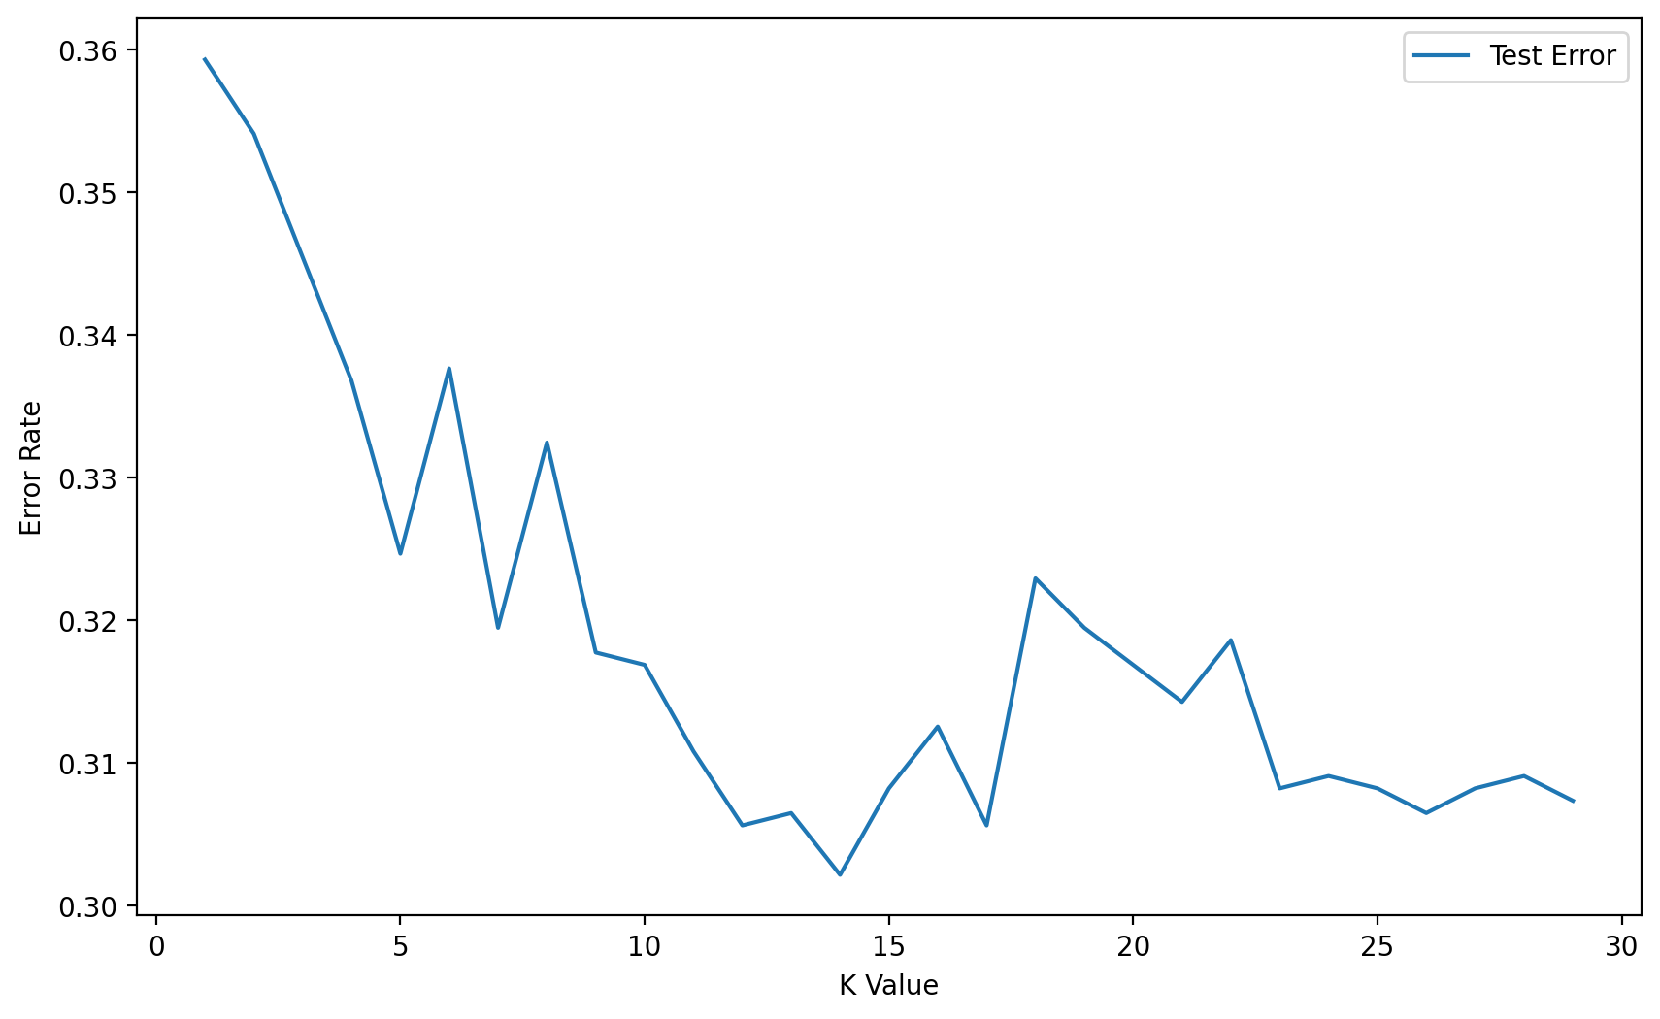
KNN Test Error

Slide 30
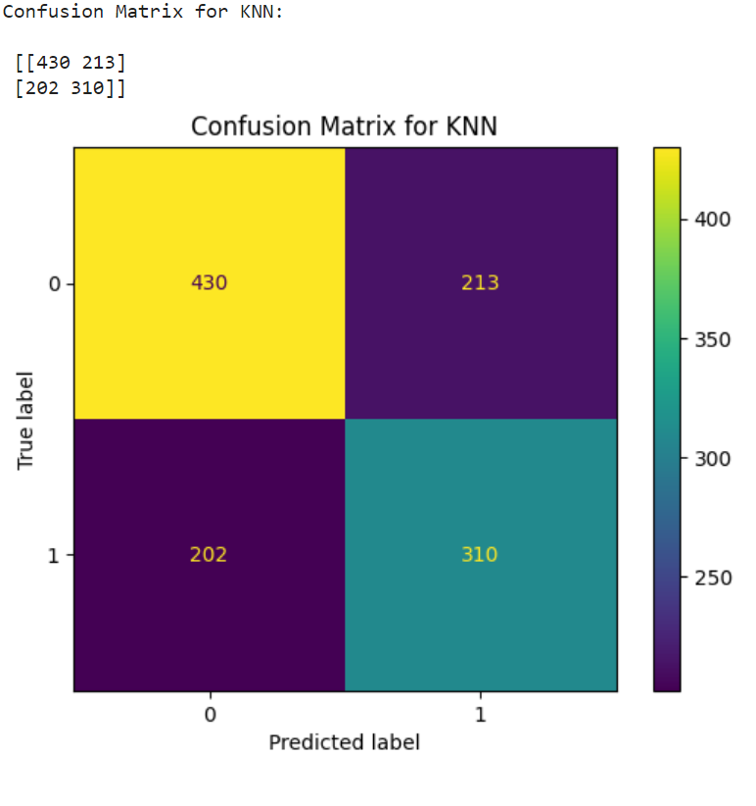
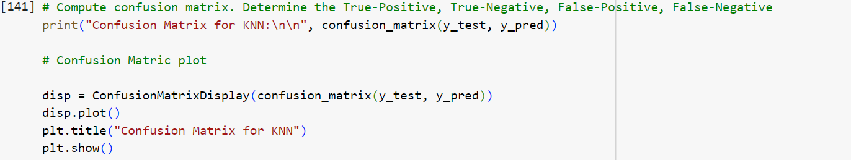
KNN Confusion Matrix Before Grid Search

Slide 31
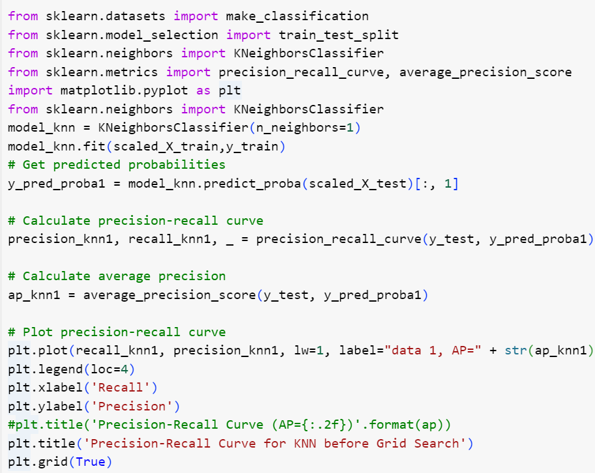
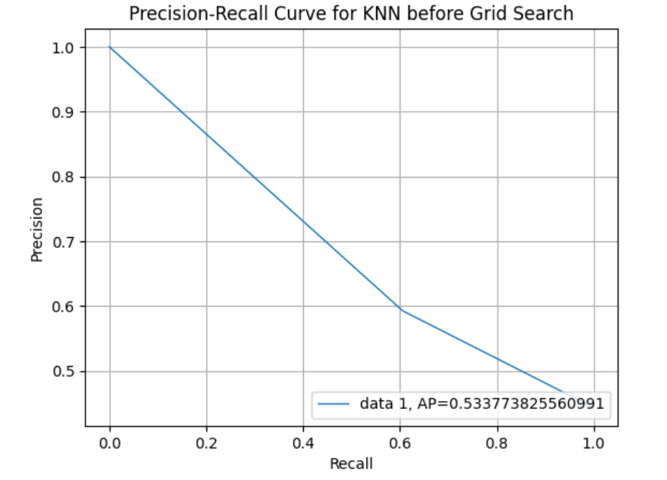
Precision-Recall Curve for KNN Before Grid Search

Slide 32
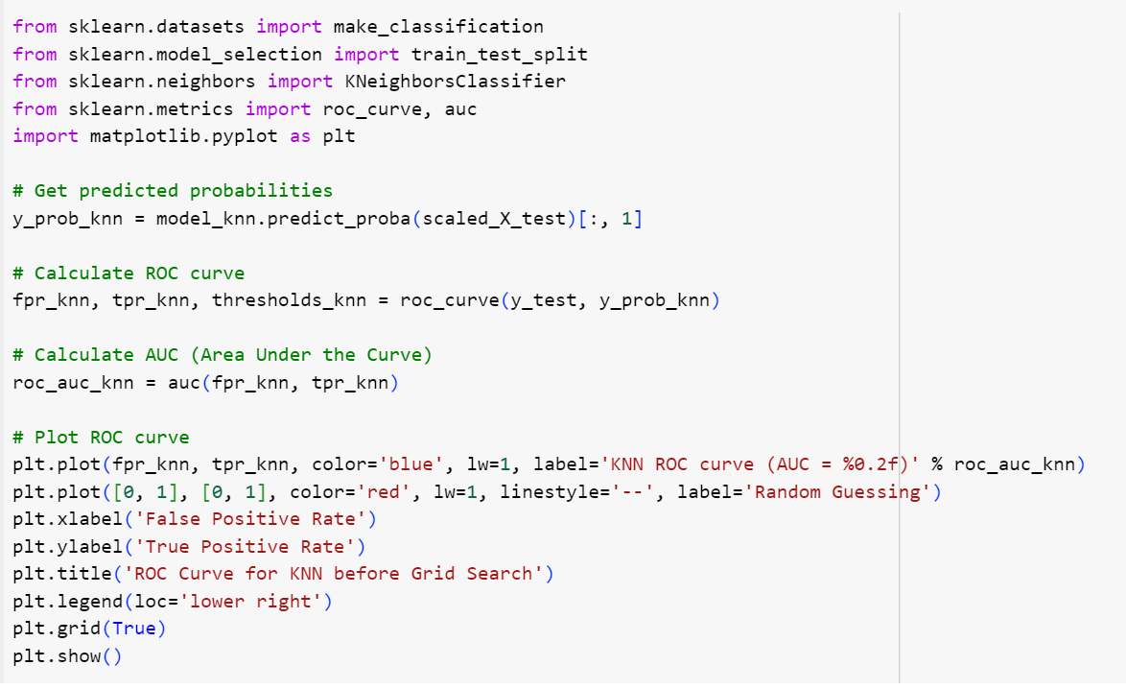
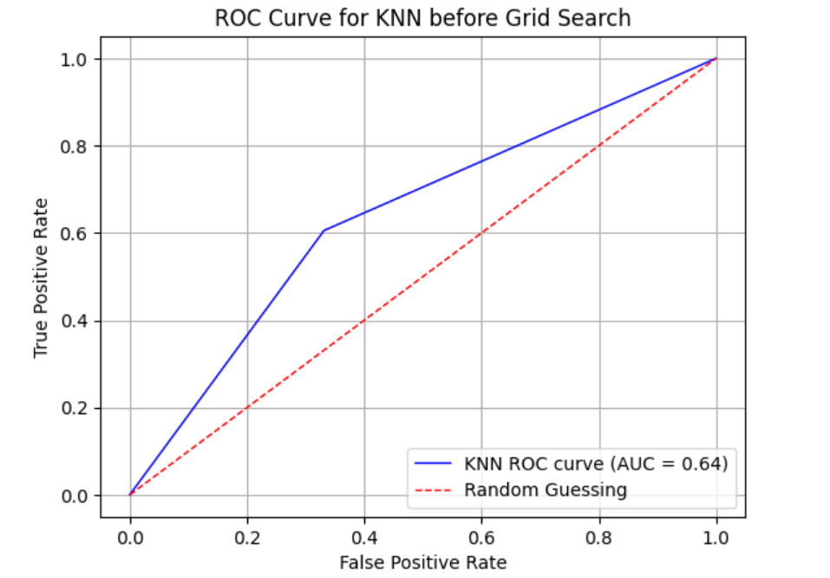
ROC Curve for KNN before Grid Search

Slide 33
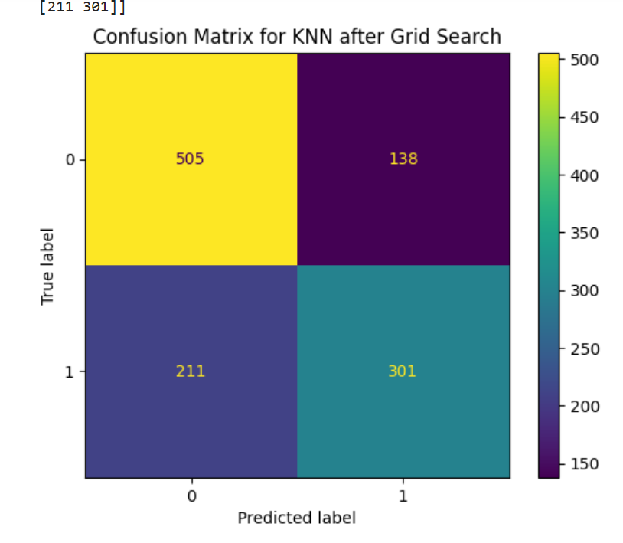
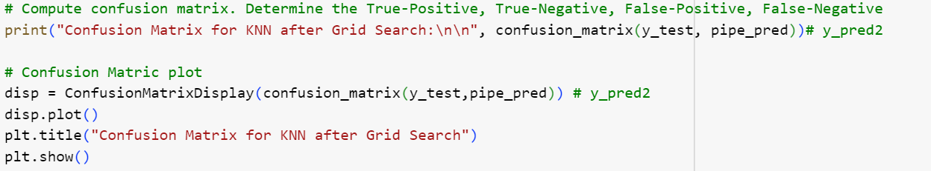
Confusion Matrix for KNN After Grid Search

Slide 34
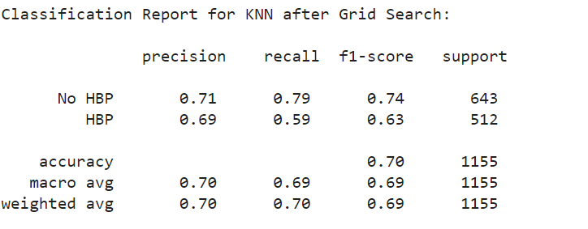
Classification Report for KNN After Grid Search

Slide 35
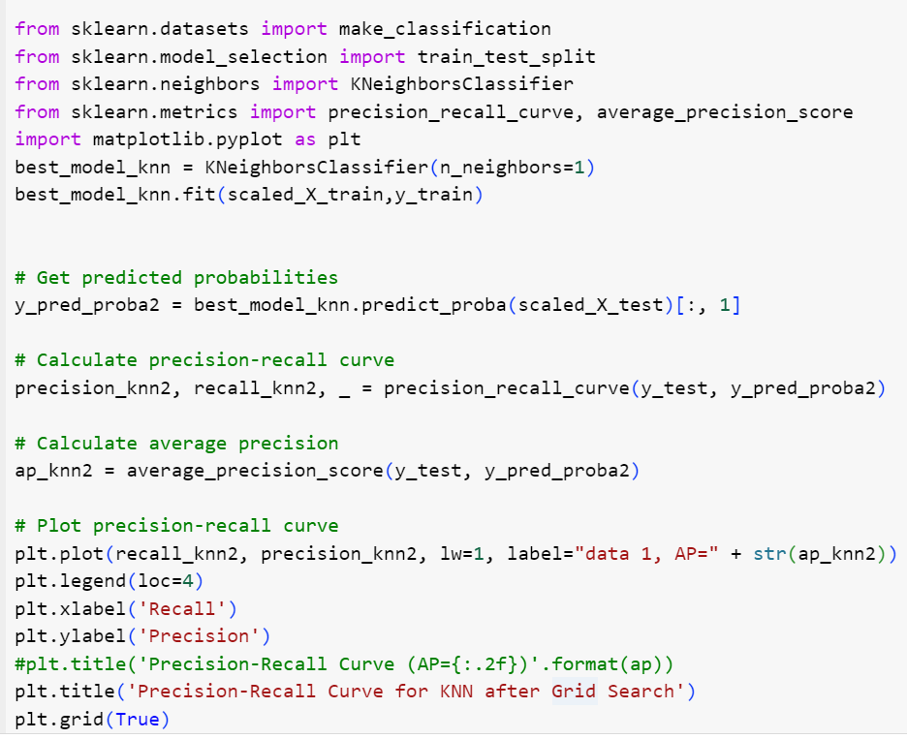
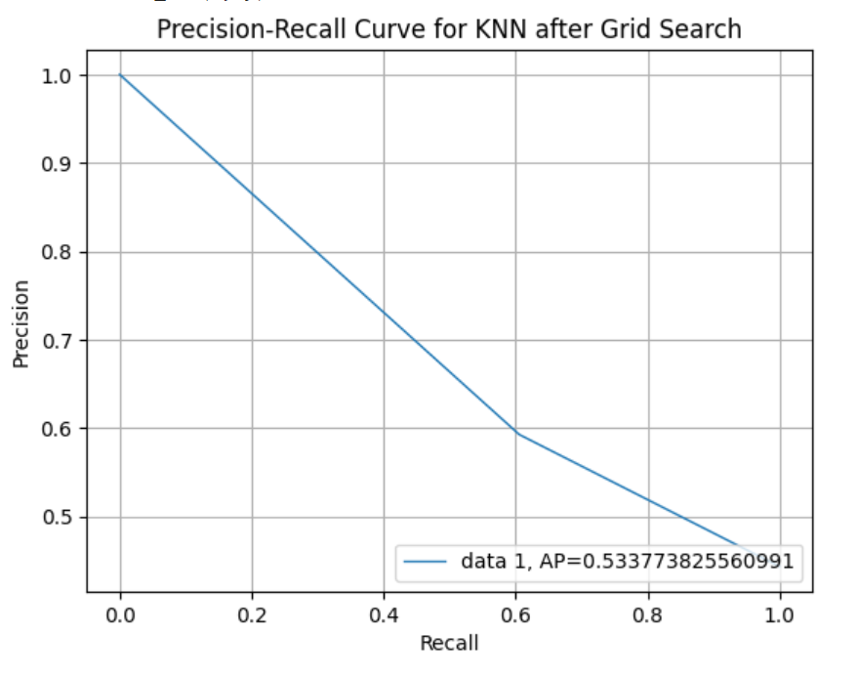
Precision-Recall Curve for KNN After Grid Search

Slide 36
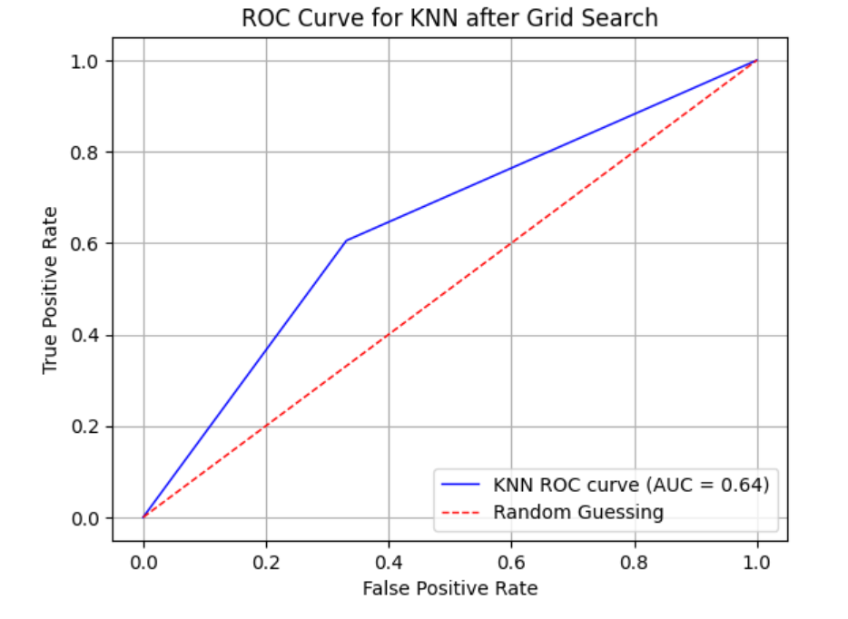
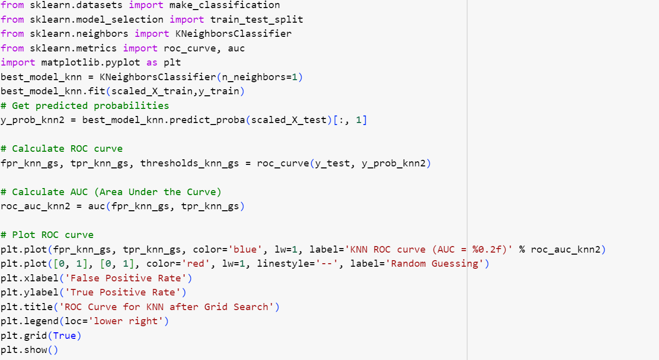
ROC Curve for KNN After Grid Search

Slide 37
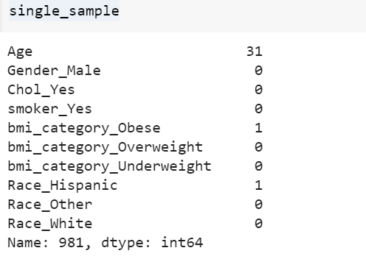
Test Data

Slide 38
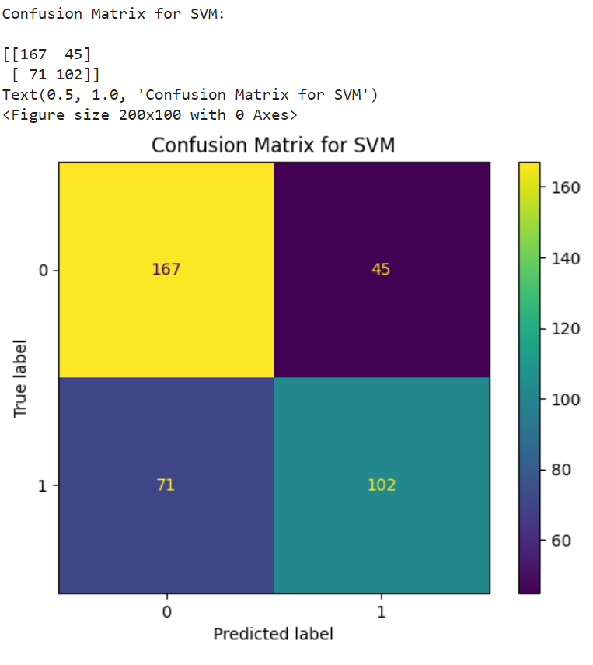
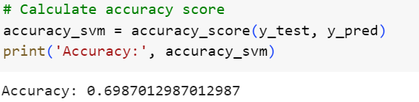
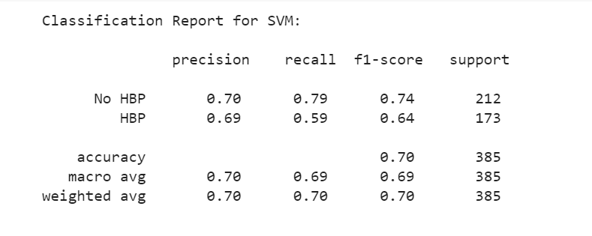
Support Vector Model
Model Performance

Slide 39
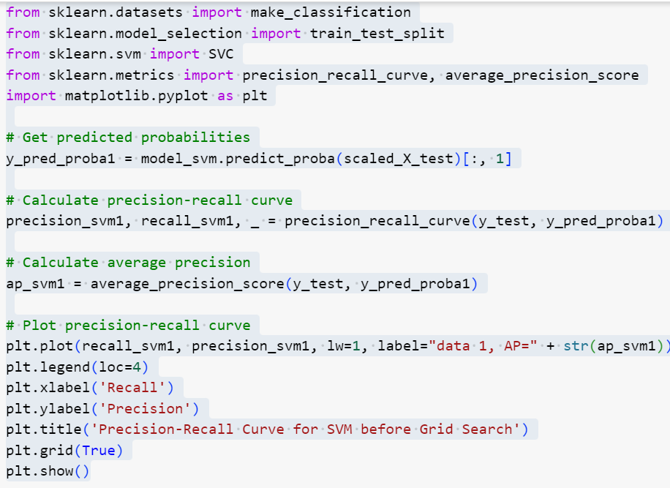
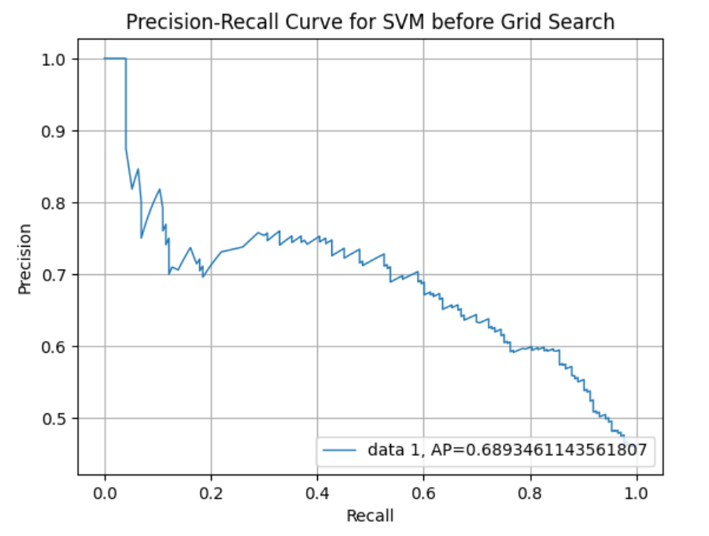
Precision-Recall Curve for SVM Before Grid Search

Slide 40
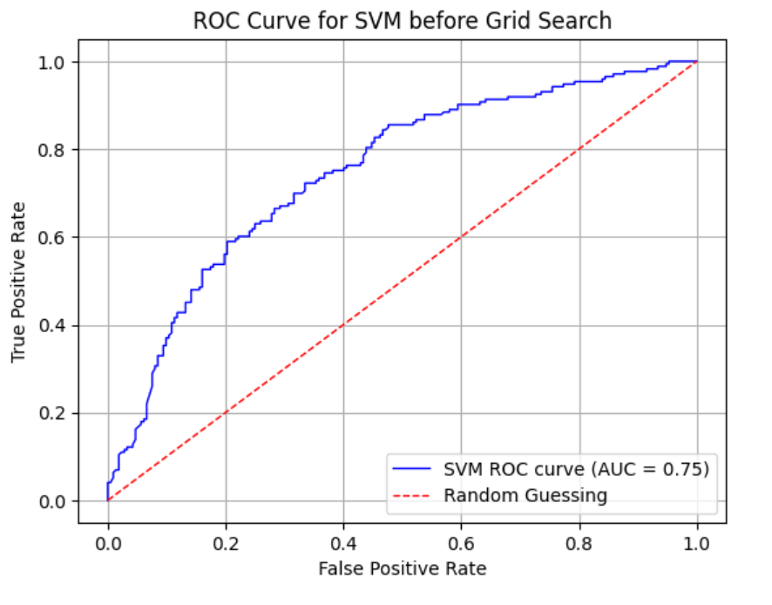
ROC Curve for SVM Before Grid Search

Slide 41
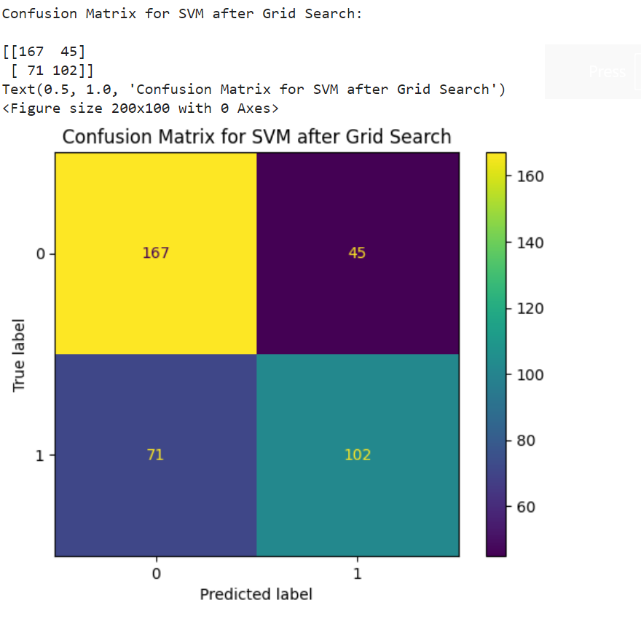
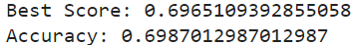
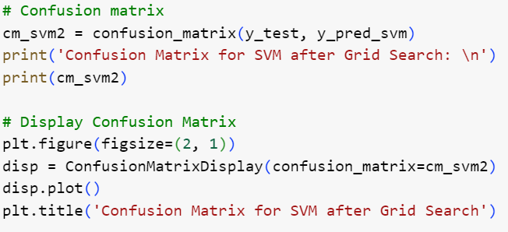
Confusion Matrix for SVM after Grid Search

Slide 42
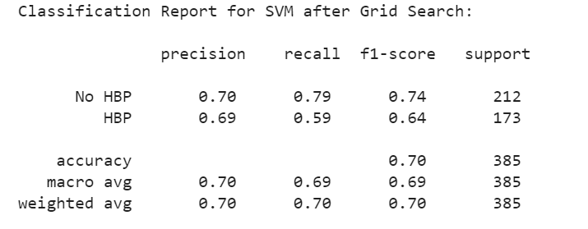
Classification Report for SVM after Grid Search

Slide 43
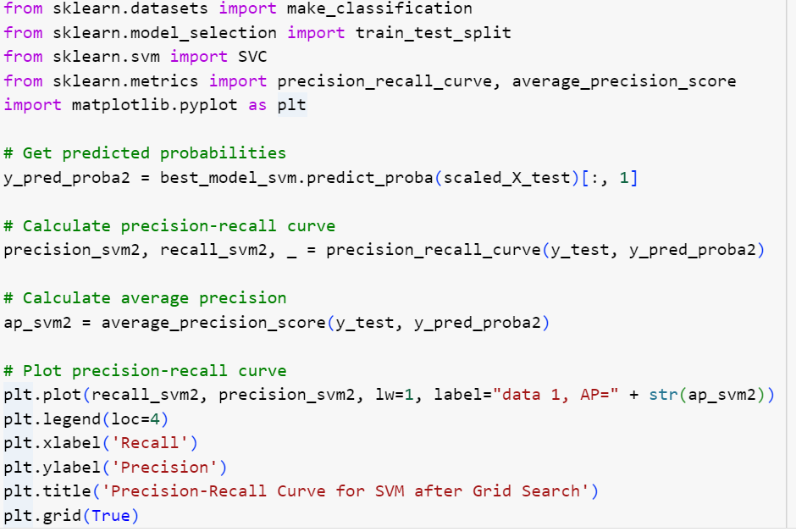
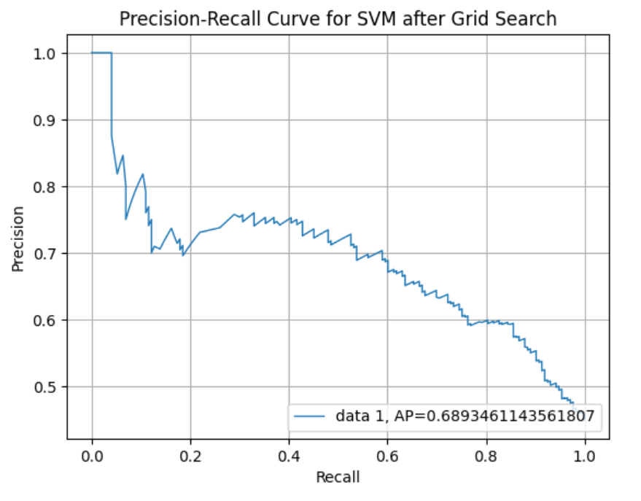
Precision-Recall Curve for SVM After Grid Search

Slide 44


ROC Curve for SVM after Grid Search

Slide 45

Confusion Matrix Decision Tree

Slide 46

Classification report for Decision Tree
Accuracy: 0.6116883116883117

Slide 47


Precision-Recall Curve for Decision Tree Before Grid Search

Slide 48


ROC Curve for Decision Tree Before Grid Search

Slide 49

Confusion Matrix for Decision Tree After Grid Search

Slide 50

Classification Report for Decision Tree after Grid Search

Slide 51


Precision-Recall Curve Decision Tree After Grid Search

Slide 52


ROC Curve Decision Tree After Grid Search

Slide 53


Visualize the Tree

Slide 54



Slide 55


Report Model Pruned Tree 1*

Slide 56


Entropy Tree

Slide 57


Confusion Matrix for Random Forest

Slide 58

Classification Report Random Forest

Slide 59

Precision-Recall Curve for Random Forest Before Grid Search

Slide 60

Random Forest ROC Curve before Grid Search

Slide 61


Exploring if Adding More Trees Improves Performance
1
2

Slide 62

Second Confusion Matrix for Random Forest After Grid Search

Slide 63

Classification Report for Random Forest After Grid Search

Slide 64

Precision-Recall Curve for Random Forest after Grid Search

Slide 65

Random Forest ROC Curve after Grid Search

Slide 66

Confusion Matrix for Gradient Boosting

Slide 67

Classification Report for Gradient Boosting

Slide 68

Second Confusion Matrix for Gradient Boosting

Slide 69

Classification Report For Gradient Boosting after Grid Search

Slide 70

Confusion Matrix for AdaBoost

Slide 71

Classification Report for AdaBoost

Slide 72

Precision-Recall Curve for AdaBoost before Grid Search

Slide 73

ROC Curve for AdaBoost before Grid Search

Slide 74

Confusion Matrix for AdaBoost after Grid Search

Slide 75

Classification Report for AdaBoost after Grid Search

Slide 76

Precision-Recall Curve for AdaBoost after Grid Search

Slide 77

ROC Curve for AdaBoost after Grid Search

Slide 78

Confusion Matrix for XGBoost

Slide 79

Classification Report for XG Boost

Slide 80

Precision-Recall Curve for XGBoost Before Grid Search

Slide 81

ROC Curve for XGBoost Before Grid Search

Slide 82

Confusion Matrix for XGBoost after Grid Search

Slide 83

Classification Report for XGBoost after Grid Search

Slide 84

Precision-Recall Curve for XGBoost after Grid Search

Slide 85

ROC Curve for XGBoost after Grid Search

Slide 86
Plans
I am a previous nutritional science major and I have an interest in cardiovascular issues. I want to further the research on the relationship between lifestyle and hypertension. I will also continue to study the machine-learning methods that the previous researchers have used as well as other variables that may contribute to hypertension.

Slide 87

Conclusion
The current research supports the idea that the risk for hypertension for middle-aged and elderly people is 90%. It is understood that hypertension increases with age and other comorbidities like high cholesterol. However, a clear relationship is not well documented. The underlying theme is that the increase in a person’s age also increases other risk factors that lead to hypertension. This is important information for stakeholders because it shows that the aging population is at risk for developing hypertension. For example, this can be used by lobbyists to demonstrate the importance of medical nutrition therapy in healthcare. It also proves the need for additional education on cardiovascular health at every age.
CDC Hypertension Prevalence Among Adults Aged 18 and Over: United States, 2017–2018

Slide 88
References
Appel, Lawrence J. "Lifestyle modification as a means to prevent and treat high blood pressure." Journal of the American Society of Nephrology 14.suppl_2 (2003): S99-S102.
Chang W, Liu Y, Xiao Y, Yuan X, Xu X, Zhang S, Zhou S. A Machine-Learning-Based Prediction Method for Hypertension Outcomes Based on Medical Data. Diagnostics. 2019; 9(4):178. https://doi.org/10.3390/diagnostics9040178
Fuchs, Flávio D., and Paul K. Whelton. "High blood pressure and cardiovascular disease." Hypertension 75.2 (2020): 285-292.
Jung, C., Jung, S. H., Lee, B., Rosenberg, M., Reaven, G. M., & Kim, S. H. (2017). Relationship among age, insulin resistance, and blood pressure. Journal of the American Society of Hypertension, 11(6), 359-365.e2. https://doi.org/10.1016/j.jash.2017.04.005
Gordon T McInnes, How important is optimal blood pressure control? Clinical Therapeutics, Volume 26, Supplement A, 2004, Pages A3-A11, ISSN 0149-2918, https://doi.org/10.1016/S0149-2918(04)90140
Erin D. Michos & Sadiya S. Khan (2021) Further understanding of ideal cardiovascular health score metrics and cardiovascular disease, Expert Review of Cardiovascular Therapy, 19:7, 607-617, DOI: 10.1080/14779072.2021.1937127
Mosca, Irene, Bláithín Ní Bhuachalla, and Rose Anne Kenny. "Explaining significant differences in subjective and objective measures of cardiovascular health: evidence for the socioeconomic gradient in a population-based study." BMC cardiovascular disorders 13 (2013): 1-8.
Jonathan Myers Exercise and Cardiovascular Health Originally published7 Jan 2003 https://doi.org/10.1161/01.CIR.0000048890.59383.8DCirculation. 2003;107:e2–e5
Vasan RS, Beiser A, Seshadri S, et al. Residual Lifetime Risk for Developing Hypertension in Middle-aged Women and Men: The Framingham Heart Study. JAMA. 2002;287(8):1003–1010. doi:10.1001/jama.287.8.1003
Prediction of Incident Hypertension Within the Next Year: Prospective Study Using Statewide Electronic Health Records and Machine Learning Ye C, Fu T, Hao S, Zhang Y, Wang O, Jin B, Xia M, Liu M, Zhou X, Wu Q, Guo Y, Zhu C, Li Y, Culver D,Alfreds S, Stearns F, Sylvester K, Widen E, McElhinney D, Ling X
J Med Internet Res 2018;20(1):e22
URL: https://www.jmir.org/2018/1/e22
DOI: 10.2196/jmir.9268

